Slide 1
Binary Addition
A publication from the Not Quite Labour party.

Slide 2
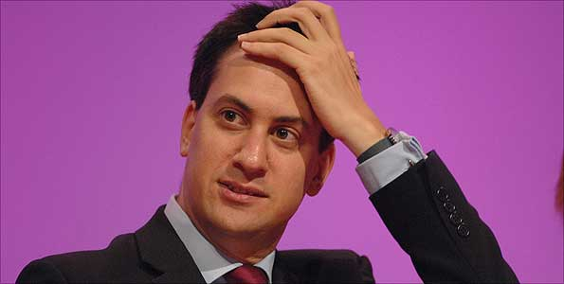
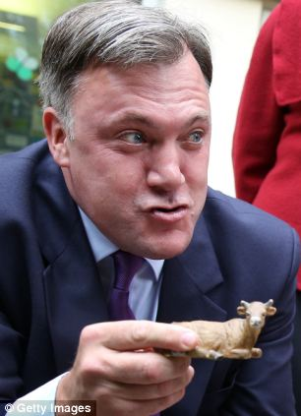
Meanwhile, Ed Balls struggles to work his new phone.
Somewhere in the Labour Party offices….
Ugh, binary addition is so hard. I wonder if Balls is still awake.
How do you work this stupid thing? Maybe I’ll just tweet my own name again…

Slide 3
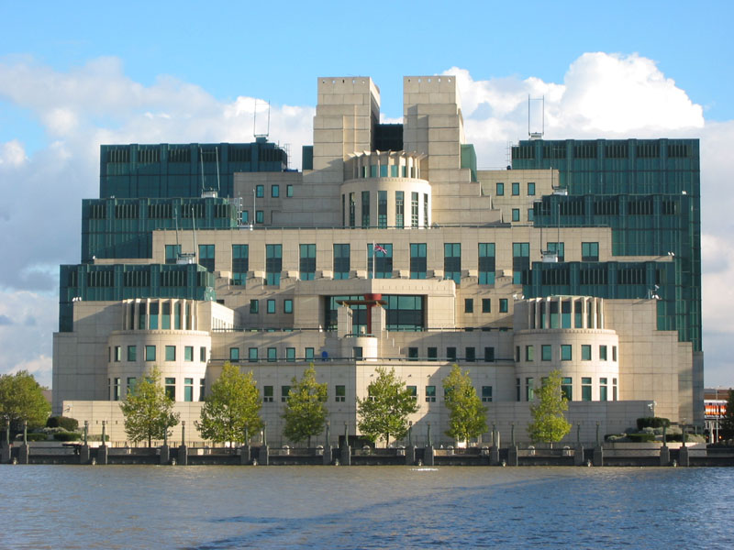
In Vauxhall…
Ed, how many times? We are not a homework help line! Dave’s going to block you on Snapchat again now.
God, Ed Miliband being on the phone must be worse than my waterboarding…

Slide 4
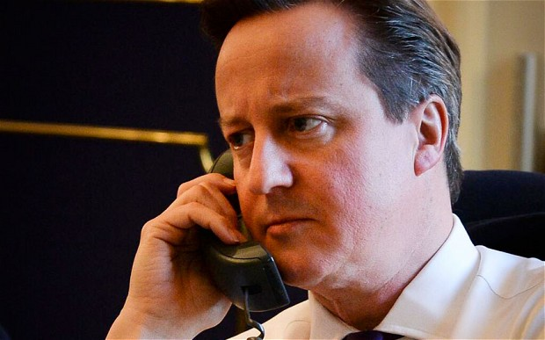
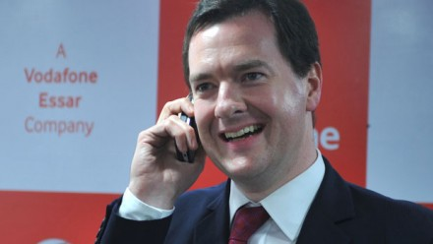
At 10 Downing Street, London…
Next door at 11 Downing Street…
Ed, you being unable to do binary addition does not mean you can ring MI6!
I’m blocking you on Snapchat for that. Isn’t it past your bedtime anyway?
Well well well, Labour comes crawling back. For crying out loud Ed, binary addition is simple!
No, well, Justine said I could stay up to watch White House down, so, yeah! Hmph!

Slide 5
George is right, binary addition is simple!
There’s a few easy rules to remember.
0 + 0 = 0
1 + 0 = 1
0 + 1 = 1
1 + 1 = 0, carry 1
1 + 1 + 1 (carried) = 1, carry 1
Simple, right?
Let’s try an example…

Slide 6
An example!
Remember the rules from the slide before? Then this should be easy!
1 + 1 = 0, carry 1
1 + 0 + carried 1 = 0, carry 1
0 + 0 + carried 1 = 1
1 + 0 = 1
So the answer is:
1 1 0 0 = 12
0 0 0 1
1 0 1 1
1 1 0 0

Slide 7
But… what about overflow errors, I hear you say?
An overflow error is where there is insufficient space to store an answer, so the answer is written as overflow error.
E.g.
1 0 1 1
1 1 1 1
1 + 1 = 0, carry 1
1 + 1 + 1 = 1, carry 1
1 + 1 = 0, carry 1
1 + 1 + 1 = 1, carry 1
OVERFLOW ERROR

Slide 8
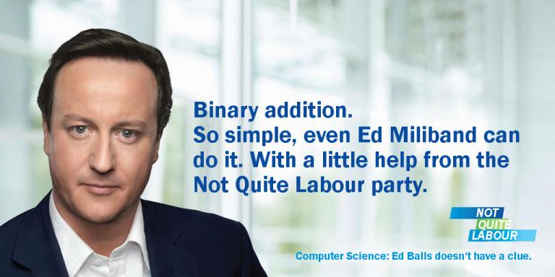

Slide 9
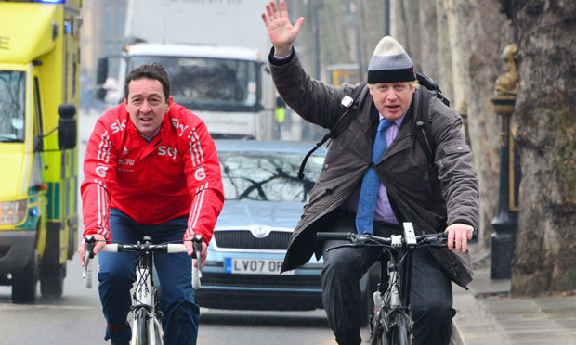
I definitely get my TV from Virgin Media, yep, Virgin, 100 %.
Sorry I’m late chaps, busy running London, you know, it’s hard work!

Slide 10
NOT QUITE LABOUR. Unifying Britain. One digit at a time.

