Slide 1
Spreadsheet skills
Notes:
Bingo starter Games: http://www.teach-ict.com/xml/finished/4313/bingo.htm

Slide 2
You are Learning today:
What are the common features of a spreadsheet ?
Why do we use them?
What features does it have that allows us to model and modify information?
Learning Objectives

Slide 3
What do these symbols mean?
/
Divide

Slide 4
What do these symbols mean?
*
Multiply

Slide 5
What do formulas always start with?
=

Slide 6
What are the answers to these questions?
= 3+2
5

Slide 7
What are the answers to these questions?
= 5*11
55

Slide 8
What are the answers to these questions?
= 32/4
8

Slide 9
What are the answers to these questions?
50+10
error

Slide 10
Spreadsheet Autopsy
Complete the Spreadsheet Autopsy.
After 2 minutes, move and ask 2 other students for points
After the 4 minute move again
Move one final time.
Add any final points and descriptions

Slide 11
Student Task 2
Let’s learn some basic skills
Log on and load up the Spreadsheet work book
Work you way through the spread sheet.
If you get stuck then, 3B4ME

Slide 12
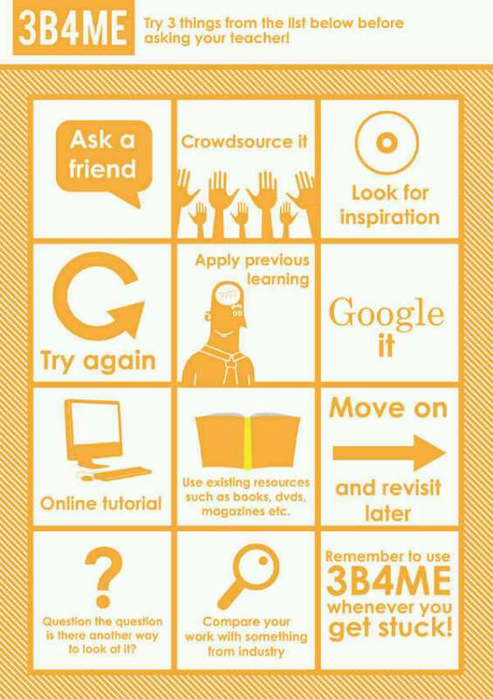

Slide 13
Plenary
Return to the Autopsy, correct any mistakes in a different colour.
Complete self skills audit
Socrative feedback sheet
What have you learnt today?

