Slide 1
CASTING
Changing one data type into another

Slide 2
Types of data in python 3
number = 3
number_as_a_string = “67”
You can print the type of data using
print(type(number))
Try a text string or other data type of you choice
Notes:
Data convert to a list requires the list function

Slide 3
Convert from a string into a list of integers
numbers_as_string = ['4', '6', '7', '12', '49', '56']
numbers_as_string = list(map(int, numbers_as_string))
Notes:
Data convert to a list requires the list function

Slide 4
Convert from string to integer
numbers_as_string = ['4', '6', '7', '12', '49', '56']
print (type(numbers_as_string))
for i in numbers_as_string:
print (type(i))
numbers_as_string = list(map(int, numbers_as_string))
for i in numbers_as_string:
print (type(i))
Notes:
How it works
Replace the int with the data type, for example, float

Slide 5
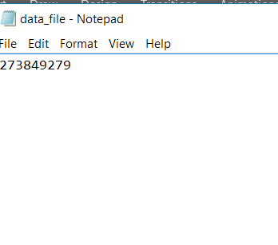
Casting of data read from a file string to a list part 1
numbers_as_string = []
print(numbers_as_string)
Create a new text file called data_file and add some numbers to it
Notes:
Open the text file and convert the values to a new list
Reads the line of data

Slide 6
Casting of data read from a file string to a list part 2
numbers_as_string = []
print(numbers_as_string)
file_obj = open('data_file' + ".txt") #opens file
numbers_as_string = file_obj.readline() #reads file contents
Notes:
Open the text file and convert the values to a new list
Reads the line of data

Slide 7
Casting of data read from a file string to a list part 3
numbers_as_string = []
print(numbers_as_string)
file_obj = open('data_file' + ".txt")#opens file
numbers_as_string = file_obj.readline()#reads file contents
print (numbers_as_string) # print values
print (type(numbers_as_string)) #print type
Notes:
Open the text file and convert the values to a new list
Reads the line of data

Slide 8
Casting of data read from a file string to a list part 4
numbers_as_string = []
print(numbers_as_string)
file_obj = open('data_file' + ".txt")#opens file
numbers_as_string = file_obj.readline()#reads file contents
print (numbers_as_string) # print values
print (type(numbers_as_string)) #print type
newlist = list(numbers_as_string) #convert to a list
print (newlist)
print (type(newlist))
Notes:
Open the text file and convert the values to a new list
Reads the line of data

Slide 9
TRY YOUR OWN
Change the data in the data_file
Add some text, what happens?
Make a new data file, add some data, open it and convert it
Create a file which converts integers into strings
Add you own twist

Slide 10
QUIZ – TRY THESE
What type of data is this, “Hi how are you today?”
What type of data is this, “01956 563425”
What data type is this, int,
Give an example
What data type is this, Up / Down
Give another example
What data type is correct for this number 3.14
Which of these is the odd one out and why, int, string, float,
Name one other data type.

