Slide 1
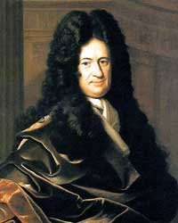
Who is it?
Gottfried Wilhelm Leibniz
He invented Binary
Binary is EASY
There are only 2 numbers 0 and 1

Slide 2
Lesson Intention
Know what Binary is
Be able to explain what Binary is
Use Binary to convert to decimal (Denary) numbers

Slide 3
What is Binary
Notes:
Explain 0 and ON and OFF

Slide 4
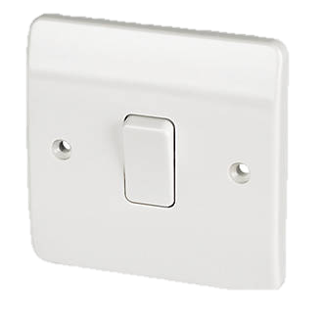
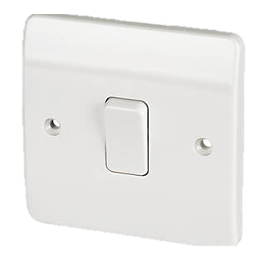
Different switches have different values
16
8
4
2
1

Slide 5
Anything with two states can be Binary

Slide 6
What value is this?
=0
=1

Slide 7
Number your fingers
Notes:
Use a pen. Number your fingers 16, 8, 4, 2, 1

Slide 8
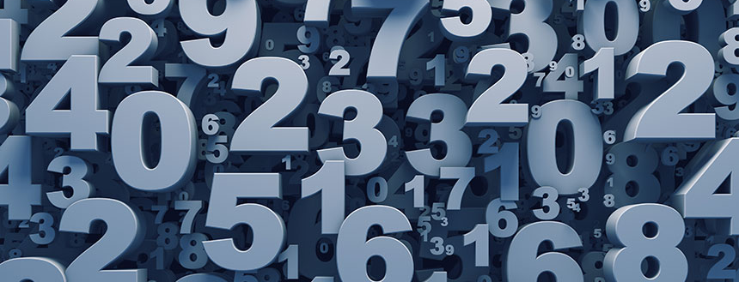
Create some numbers
Use Binary fingers to make some numbers, challenge another student to make a number

Slide 9
Can you work out the rest of the Binary for the Alphabet?
A = 1 = 00001
B = 2 = 00010
C = 3 =

Slide 10
How many did you get correct?

Slide 11
Binary Gossip: Code some secret messages
Use binary code to right a secret / private / gossipy message to a friend.

Slide 12
Challenge
Only use binary fingers

