Slide 1
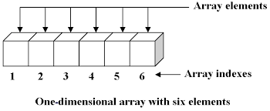
2d Arrays

Slide 2
2D Arrays: the list can be thought of as being stored in a table in columns and rows - a matrix
list = [["1", "2", "3"], ["4", "5", "6"], ["7", "8", "9"]]
Pos | 0 | 1 | 2
0 | 1 | 2 | 3
1 | 4 | 5 | 6
2 | 7 | 8 | 9
Notes:
The left hand column refers to each sub list, start from 0, the top row is the postion number.
For example what number is at List 1 position 1? = 5

Slide 3
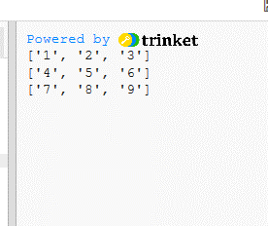
2D Array (Lists within a list) Print as a tabbed grid
list = [["1", "2", "3"], ["4", "5", "6"], ["7", "8", "9"]]
print (list)
To print as a table use:
for i in list:
print (i)
ITERATION
“I” means integer
Notes:
The array called list is made up of three separate lists

Slide 4
Print individual data from a specific list or column
students = [["dave", 14, "11DA"], ["liz", 18, "7ED"], ["kerry", 7, "8MD2"]]
print (students)
print(students[0][2])
print(students[2][2])
Print(students[1][3])
(the first number say [0] is the list number and the second number [2] is the position of the data to be printed, list 0, position 2, = 11DA)
Notes:
You have to refer to the list number ad the position of the item in that list
What do the three examples print?
Prints 11DA
Prints 8MD2
Nothing – error there is no third item.

Slide 5
Print one data element from a specific column in each list, (print one column)
students = [["dave", 14, "11DA"], ["liz", 18, "7ED"], ["kerry", 7, "8MD2"]]
print (students)
Print just the ages:
for i in students:
print(i[1])
(where i is each of the individual lists and [1] refers to the position one in each list, the age, alter the code to print the tutor group)
Notes:
To print all the data from one column, select the arry name and use a loop to iterate through

Slide 6
Print one data element from a specific column in each list, (print one column)
students = [["dave", 14, "11DA"], ["liz", 18, "7ED"], ["kerry", 7, "8MD2"]]
Task
Print items just in the names column:
for i in students:
print(i[???])
Notes:
Another Example

Slide 7
Another method to print columns
list = [["1", "2", "3"],
["4", "5", "6"],
["7", "8", "9"]]
print (list)
for x in range(0, 3):
print(list[x][0])
Notes:
X is the row so it states for each row from 0 to 2, as there are three rows, print the item at position 0, the first entries.

Slide 8
Print the third column using x axis
list = [["1", "2", "3"],
["4", "5", "6"],
["7", "8", "9"]]
print (list)
for x in range(0, 3):
print(list[x][2])
Notes:
X is the row so it states for each row from 0 to 2, as there are three rows, print the item at position 2 the third item in each of the lists
Remember position starts from 0, item number is from 1

Slide 9
Print the third column – using y axis
list = [["1", "2", "3"],
["4", "5", "6"],
["7", "8", "9"]]
print (list)
for y in range(0, 3):
print(list[y][2])
Notes:
y is the column so it states for each column from 0 to 2, as there are three columns, print the item at position 2, the third entry.

