Slide 1
Algorithms

Slide 2
Key Terms
Abstraction
Abstraction means reducing something to a very simple set of characteristics, chosen to be most relevant to the problem. A pattern or structure.
Decomposition
Looking for patterns among and within the smaller problems that make up the complex problem. Decomposition means breaking down a large problem into smaller chunks that can be solved using computing.
Algorithmic thinking
A method of getting to a solution through the clear definition of the steps needed. There are instructions or rules that if followed precisely (whether by a person or a computer) leads to answers to both the original and similar problems.

Slide 3
Consider this issue
Is this a picture of a CAT?

Slide 4
What are these symbols called?

Slide 5
What are these symbols called?
Data Flow
Process
Input / Output
Decision

Slide 6
Work out which instructions are what?
Process
Decision
Input / Output

Slide 7
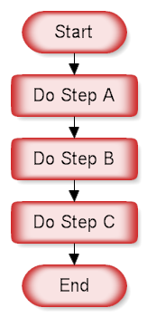
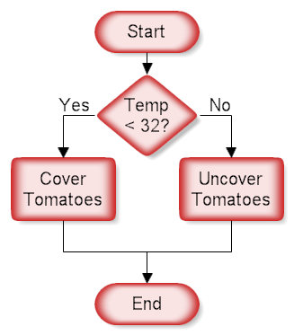
Algorithms

Slide 8
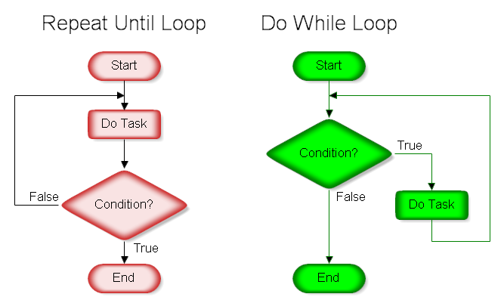

Slide 9
Sort the colours of the rainbow
What are the colours of the rainbow?
Are they in order?
What happens if they are not in order?
Create an algorithm for sorting them into the correct order

Slide 10
What learnt today?

