Slide 1
Unit 2.6 Data Representation Lesson 2 ‒ Characters

Slide 2
Starter Question
If you type your name into the keyboard, how does the computer know how to show the correct characters?
Watch this video which may help!
https://www.youtube.com/watch?v=JwWoVQXQ24k

Slide 3
Learning Objectives
Explain the use of binary codes to represent characters
Know the term character set
Describe with examples (for example ASCII and Unicode) the relationship between the number of bits

Slide 4
How many bits would you need to code an entire keyboard?
How many keys are there on a normal keyboard?
Notes:
What is a bit?
What is a Byte?

Slide 5
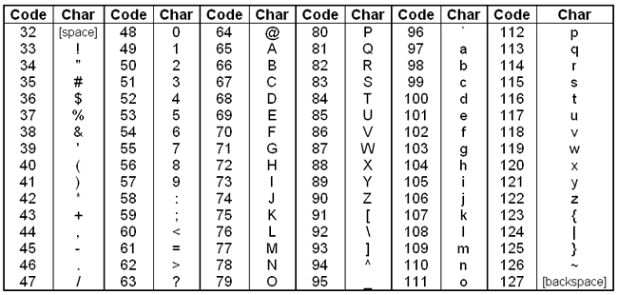
Using these decimal codes, what would the word Computing look like?

Slide 6
The code used to translate language between computers and people is called ASCII:
It is pronounced ‘askee’

Slide 7
ASCII is short for:
American Standard Code for Information Interchange

Slide 8
In ASCII the word "cat" would be:
1000011 1100001 1110100

Slide 9
ASCII:
is the standard code used by computers everywhere to represent the Strings and Numbers you can type using the keyboard

Slide 10
Activity 1
Using the character codes in the table, write a message in binary for the person sat next to you. Swap messages and ask them to decode it!

Slide 11
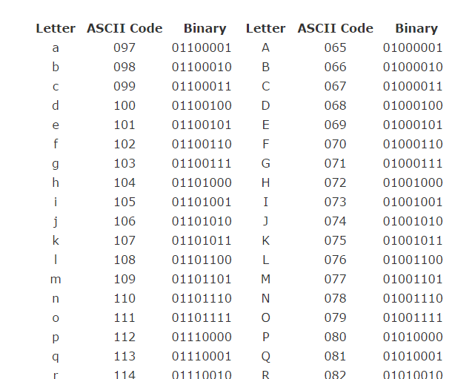
ASCII conversion table:

Slide 12
You try
On a blank sheet of paper, write your name
Using the ASCII chart, lookup the binary values for each letter and write it down in a series
Don’t forget the spaces between your letters
Give your encoded name to a friend
Have them decode the code

Slide 13
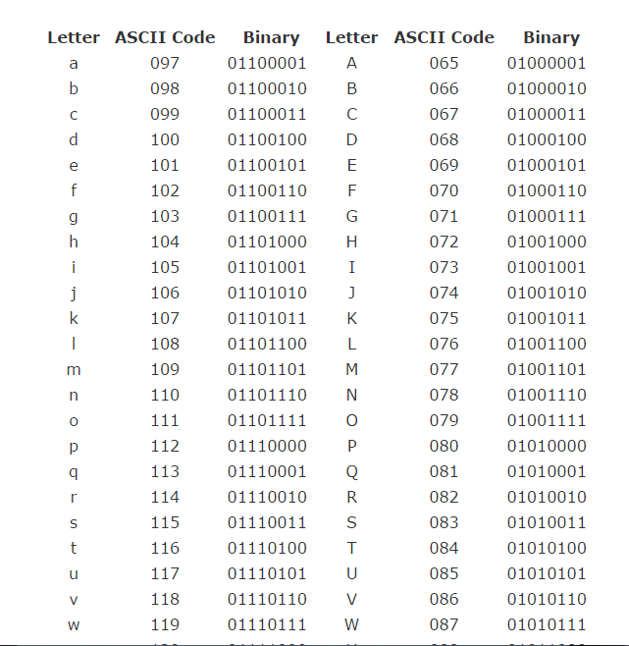

Slide 14
How many bits are required to store ASCII codes?
8 bits can store 256 characters
ENGLISH Keyboard uses 128 characters what are the others codes used for?

Slide 15
Extended ASCII:
languages such as
German, French, Finnish, Irish, Icelandic,
take advantage of the other 128 spaces to include their
own special characters.
e.g. the German umlaut ü is 11011100
Notes:
What is the value of 11011100? =

Slide 16
The term character set is used to describe a digital representation of text:
ASCII is the most widely used character set
The entire collection of characters available in a system such as ASCII is called a character set.

Slide 17
Character Set
ASCII and Unicode are the most widely used character sets.
The term Character set is used to describe the possible characters that can be represented in a computer system.

Slide 18
Other character sets in common use are:
Extended ASCII (8 bits – 256 characters)
UTF-8 (8 bits – 256 characters)
Unicode (16 bits – 65536 characters)

Slide 19
Number of bits
ASCII uses 1 byte to store all of the characters needed for the English language.
This gives 256 possible characters which is enough for the English language.
However what would other languages use such as Arabic where they have thousands of characters?

Slide 20
Unicode
unicode was developed to account for every language in the world.
it uses 2 bytes that give us 2¹⁶ possibilities (65,536).
an example use of this would allow a user from any country to select their language when setting up an operating system. the unicode character set would account for every language.

