Slide 1
Unit 2.6 Data Representation Lesson 1 ‒ Numbers

Slide 2
Starter
Put these units in the correct order of size
(smallest->largest):
Bit
Gigabyte
Kilobyte
Byte
Petabyte
Terabyte
Megabyte
Nibble

Slide 4
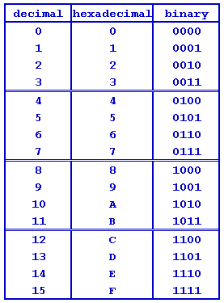

Slide 5
Hexadecimal Numbers
Hexadecimals use the base-16 number system.
This means that there are 16 possibilities:
0,1,2,3,4,5,6,7,8,9,A,B,C,D,E,F
Notice that we use the values A-F to represent 10-15

Slide 6
Convert to base 10
Base 16 is represented by the following place values:
Therefore to convert 4C from Hexadecimal into base 10:
256(16²) | 16(16¹) | 1(16⁰)
256(16²) | 16(16¹) | 1(16⁰)
 | 4 | C
 | 4*16=64 | 12*1=12
64+12=76

Slide 7
Convert to Hexadecimal
Using the inverse, we can convert from to Hexadecimal by using the following method:
e.g. Convert 167 into Hexadecimal
Divide the number by 16:
167/16= 10(A)
2. Record the remainder:
Remainder = 7
Therefore the answer = A7

Slide 8
Binary to Hexadecimal
Using 4 bits (a nibble) we can hold 16 possible decimal values. 0000 = 0
1111 = 15
This is useful when convert between Binary and Hexadecimal (base 16).
To convert 10101011 into Hex, we can use the following steps:
Split into 2 nibbles: 1010 1011
Convert each nibble into decimal: 1010 = 10(A) 1011 =11(B)
Therefore 10101011 in Hex is AB

Slide 9
Hexadecimal to Binary
To convert from Hexadecimal to Binary we can do the opposite, where we convert each digit into a nibble.
To convert 3B into Hex, we can use the following steps:
Split into 2 digits: 3 B
Convert each digit into 4 bits (a nibble!):
3= 0011 B=1011
Therefore 3B in Binary is 00111011

Slide 10
Why use Hexadecimal Numbers?
Hexadecimals are used by computer scientists for the following reasons:
Binary produces long strings and can be difficult to work with. Hex is shorter.
Hex can be easily converted to/from binary as there is 1 hex digit per nibble.
Hex is less susceptible to error.

