Slide 1
Unit 2.5 Translators and Facilities of Languages – Lesson 1

Slide 2
Contextual Video
https://www.youtube.com/watch?feature=player_embedded&v=1OukpDfsuXE

Slide 3
Big Picture – Lesson Activity 1
How does code need to be written for a Computer to Understand?
How does code need to be written for a programmer to understand?

Slide 4
Learning Objectives
To be able to describe the different generations of programming language
To be able to describe the differences between Low Level and High Level Languages
To evaluate the benefits of programming in both Low and High Level languages
To state which translator is needed for each and why

Slide 5
Engagement – Activity 2
Identify the errors in a section of Machine Code that you have been given.
What are the issues to the programmer?
Imagine if the code was much larger?
What are the advantages of programming in the language that you are familiar with?

Slide 6
Key Words
Low Level Language
High Level Language
1st Generation
2nd Generation
3rd Generation
Machine Code
Language Translator
Assemble
Compiler
Interpreter
Device Driver
Debug

Slide 7
Content
There are several Generations of Programming Languages
Low Level
1st Generation
2nd Generation
High Level
3rd Generation
4th Generation

Slide 8
1st Generation
Machine Code
Directly Executable by the processor
The Generation that “computers understand”
Difficult to program in, hard to understand, hard to find errors (hard to debug)

Slide 9
2nd Generation
Assembly Code
Uses mnemonics
Easier to program in than 2nd Generation but still difficult.
One Assembly Language instruction translates to one Machine Code Instruction (1-1 relationship)

Slide 10
2nd Generation
Needs to be translated into Machine Code for the computer to be able to execute it
Uses an Assembler
Assembler – Assembles Assembly Language

Slide 11
2nd Generation
Despite 2nd Generation being difficult to Debug it still has its uses
Debug means to go through the code to search for where/why an error has occurred
It is most commonly used to program Device Drivers
Device Drivers are loaded into memory by the Operating System and used to control the operation of a Hardware Device e.g. Graphics Card Drivers, Printer Drivers.

Slide 12
3rd Generation
Easier to understand (programmer)
Easier to find errors, easier to de-bug
Uses English-Like Keywords
One instruction translates into many machine code instructions
E.g.’s Java, Basic, Pascal, C+

Slide 13
3rd Generation
Translated using:
Compiler
Interpreter

Slide 14
4th Generation
Known as a Declarative Language
Facts and Rules are stated
Describes what computation should be performed and not how to perform it
Examples include:
SQL
Expert Systems
Artificial Intelligence

Slide 15
Activity 3 – Identify the generation
Dim Num1, Num2, Tot as Integer
Num1 = Console.Readline()
Num2 = Console.Readline()
Tot = Num1 + Num2
Console.Writelein(“Total is: “ & Tot)
High Level (3rd Generation)
01010101010100101010100101010101010011111001000100001010100101
Low Level (2nd Generation)
LOAD r1, c
LOAD r2, d
ADD r1, r2
DIV r1, #2
Low Level
(1st Generation – Machine Code)

Slide 16
Activity 3 - Answer
Dim Num1, Num2, Tot as Integer
Num1 = Console.Readline()
Num2 = Console.Readline()
Tot = Num1 + Num2
Console.Writelein(“Total is: “ & Tot)
High Level (3rd Generation)
01010101010100101010100101010101010011111001000100001010100101
Low Level (2nd Generation)
LOAD r1, c
LOAD r2, d
ADD r1, r2
DIV r1, #2
Low Level
(1st Generation – Machine Code)

Slide 17
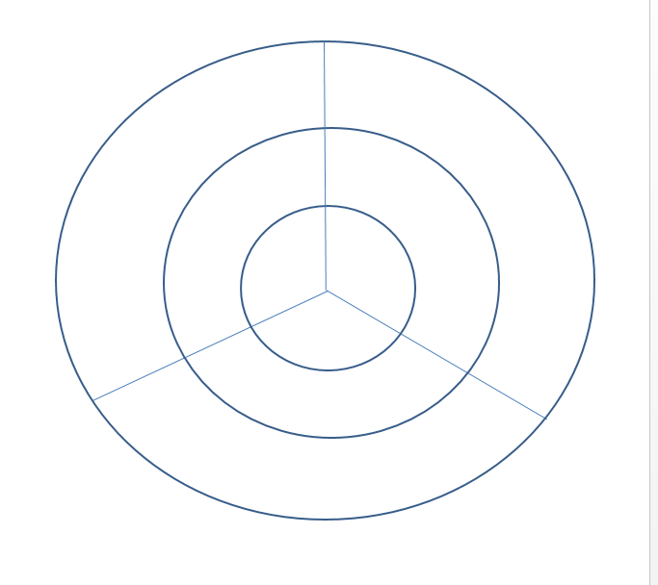
Activity 4
Produce Graphics organiser to identify the differences between the different Generations of Programming Languages using the following method:

Slide 18
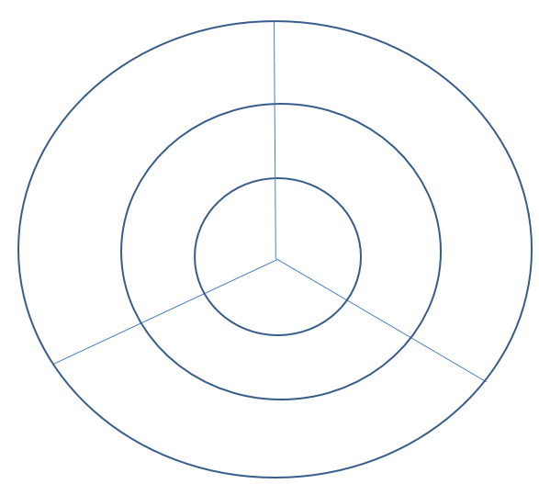
Activity 4 - Answer
Machine code:
Directly Executable by CPU
Doesn’t need a translator
0’s and 1’s
Difficult to program in, Hard to understand, Hard to De-Bug
Low Level
Needs translating into Machine Code
1-1 relationship between Assembly Instruction and Machine Code
No Translator
Assembler
1st
2nd
High Level
Easier for programmer to understand,
de-bug and write
1-Many relationship
Use’s English like Key words
3rd
Compiler / Interpreter

Slide 19
Plenary
Programming Parliament
Split class into groups
Each group is given a generation of programming language (1st, 2nd or 3rd)
They have 10 minutes to prepare an argument as to why their generation is best
Students then vote on which argument ‘won’ at the end of the debate

Slide 20
OCR Resources: the small print OCR’s resources are provided to support the teaching of OCR specifications, but in no way constitute an endorsed teaching method that is required by the Board, and the decision to use them lies with the individual teacher. Whilst every effort is made to ensure the accuracy of the content, OCR cannot be held responsible for any errors or omissions within these resources. © OCR 2016 - This resource may be freely copied and distributed, as long as the OCR logo and this message remain intact and OCR is acknowledged as the originator of this work.
OCR acknowledges the use of the following content: n/a
Please get in touch if you want to discuss the accessibility of resources we offer to support delivery of our qualifications: resources.feedback@ocr.org.uk

