Slide 1
How hard is it for a computer to draw a straight line?
Must be easy?

Slide 2
How does a computer draw a straight line.
Logon on,
then Research-
Find a simple definition of a straight line
Can you prove it?.
Be prepared to explain. Your answer.

Slide 3
Draw a straight line on paper,
use a ruler and label one end A and the other end B.

Slide 4
Load Paint-
Start/ All programs/Accessories/ Paint
Draw a straight line, using the straight line tool.
How does it work?

Slide 5
Anchor
Extension
Retraction
Prove with an elastic band

Slide 6
Back to Paint.
Magnify your line.
What do you see . Be prepared to explain your answer.

Slide 8
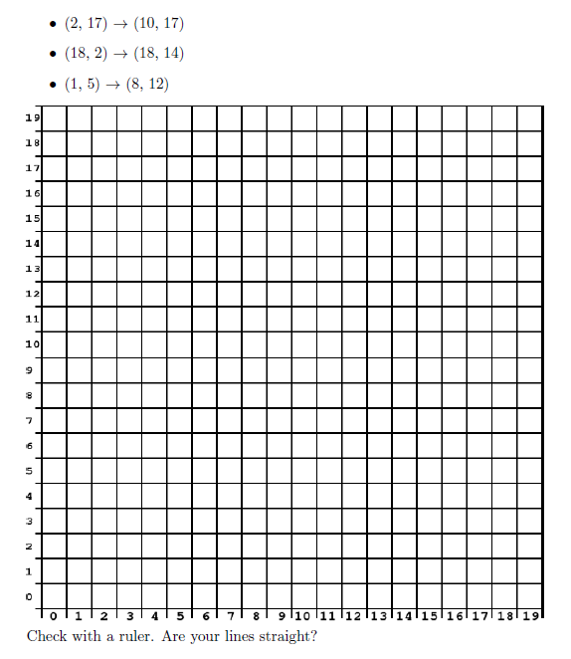
Can you draw a straight line the same way Paint does?
TASK ONE

Slide 9
TASK TWO

Slide 10
Bresenham's Line Algorithm
A = 2 x change in Y value
B = A -2 x change in X value
P = A - change in X value

Slide 11
For every position along the X axis:
if P is less than 0, draw the new pixel on the same line as the last pixel, and add A to P.
if P was 0 or greater, draw the new pixel one line higher than the last pixel, and add B to P.
continue this process until we reach the end of the line.

Slide 13
Bresenham's Line Algorithm
A = 2 x change in Y value
B = A -2 x change in X value
P = A - change in X value

Slide 14
Hang Man
Push your teams colored button when you miss a question
OUT
OUT
OUT

Slide 15
Write a poem about what you have learnt today.

